Slide 1

Talk about Video Processing from P3D Learning Spatio-Temporal Representation with Pseudo-3D Residual Networks
Li Wenxi
November 23, 2018

Slide 2
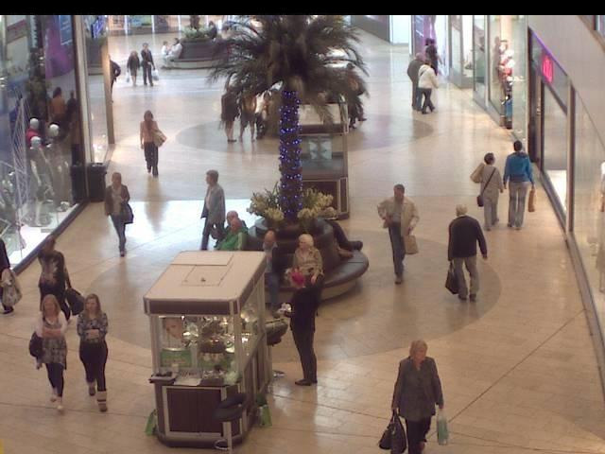
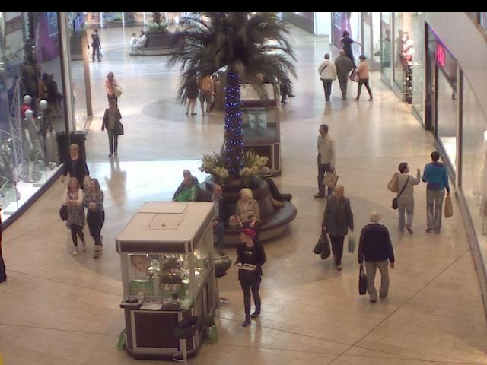
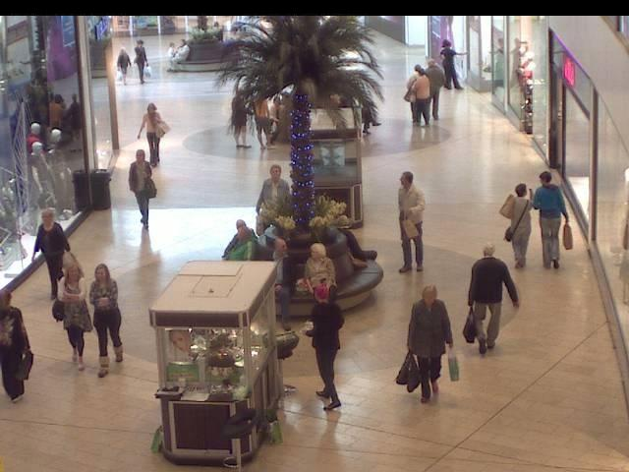
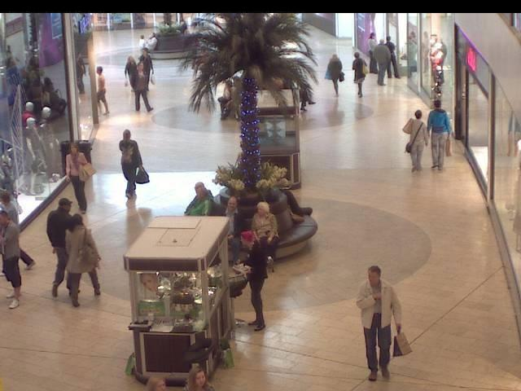
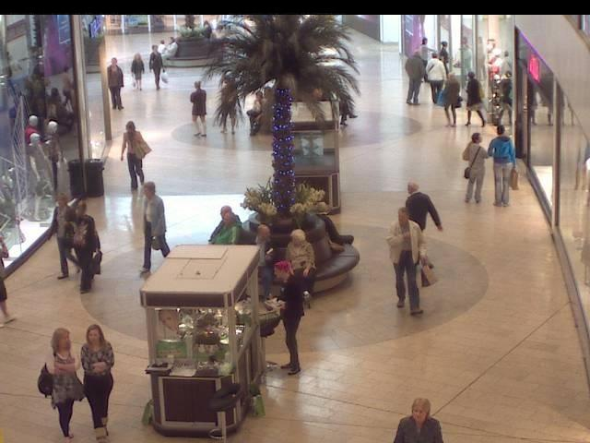
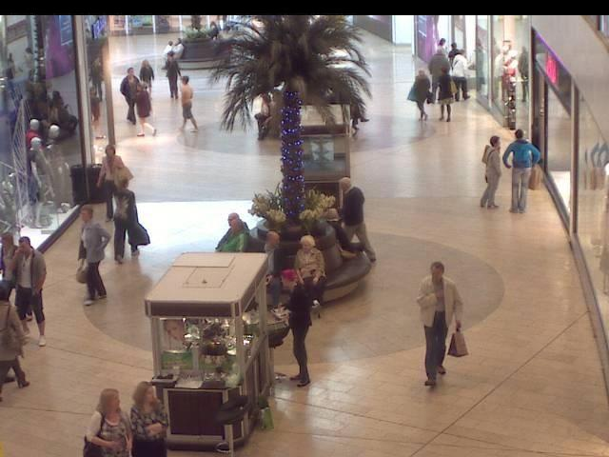
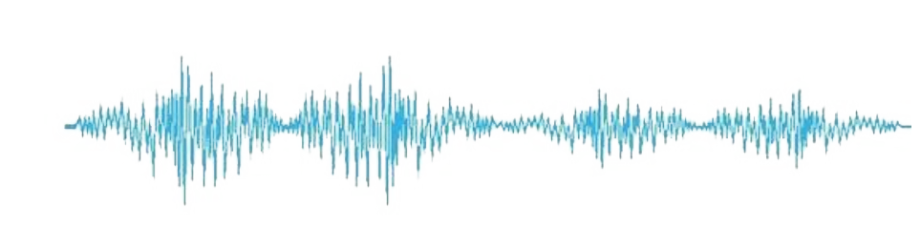
What is the difference between pictures and videos?

Slide 3
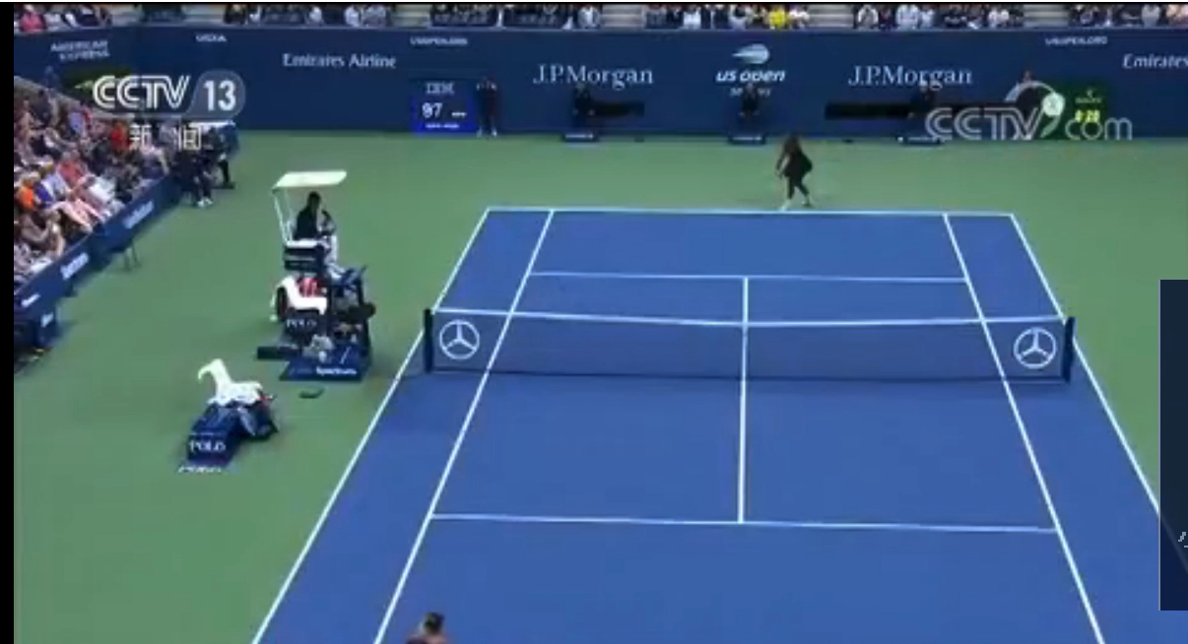
Why use temporal stream?

Slide 4
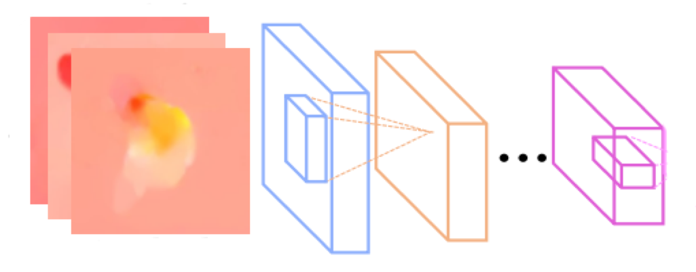
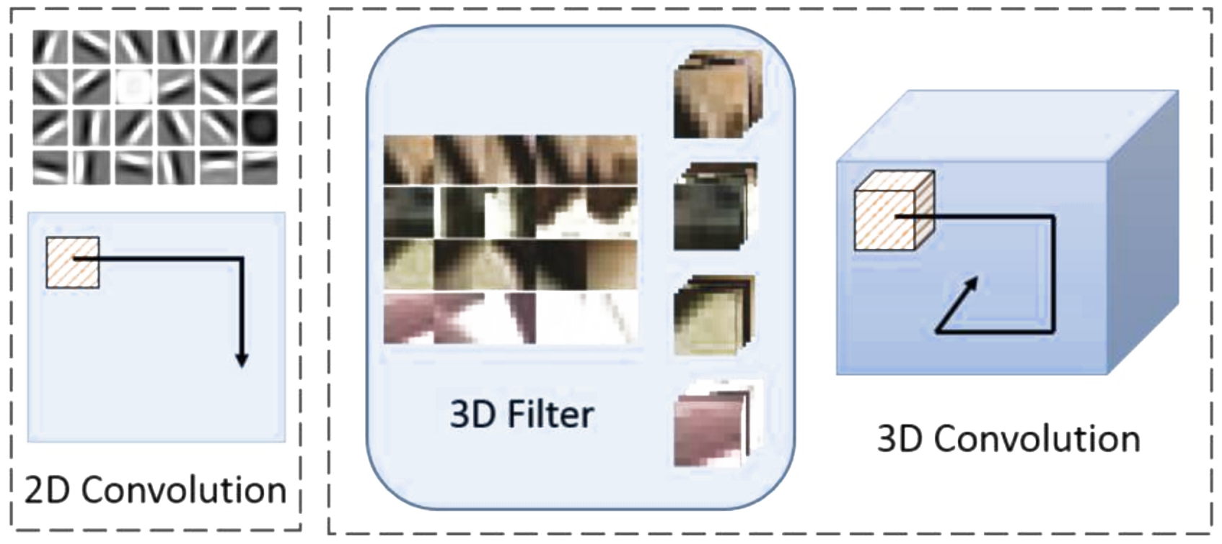
Frame
Optical Flow
Network
LSTM
3D Convolutional Neural Networks

Slide 5
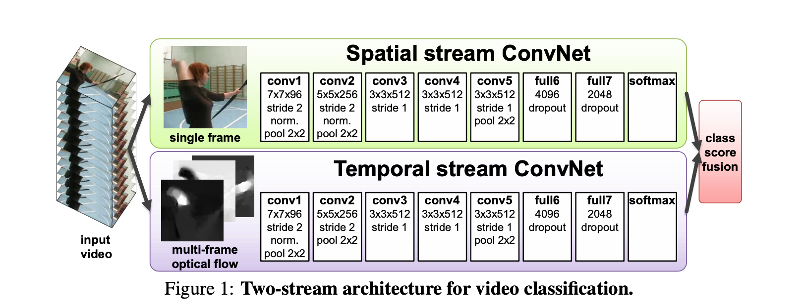
Optical Flow
Two-Stream Convolutional Networks for Action Recognition in Videos (NIPS 2014)

Slide 6
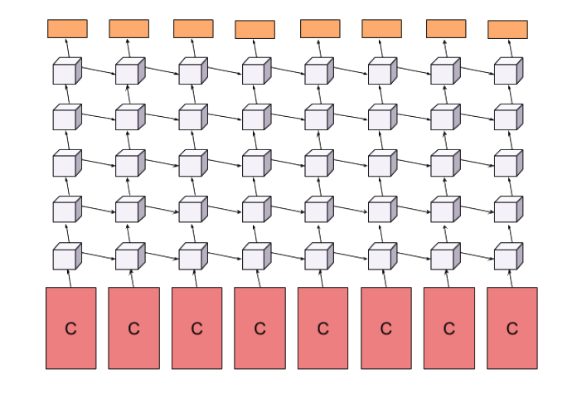
Add LSTM
Beyond shorts-nippets: Deep networks for video classification (CVPR 2015)
Notes:
网络大
使用高级特征

Slide 7
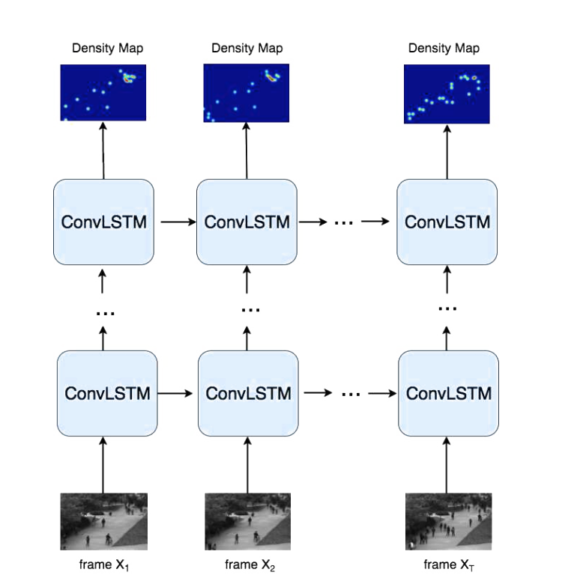
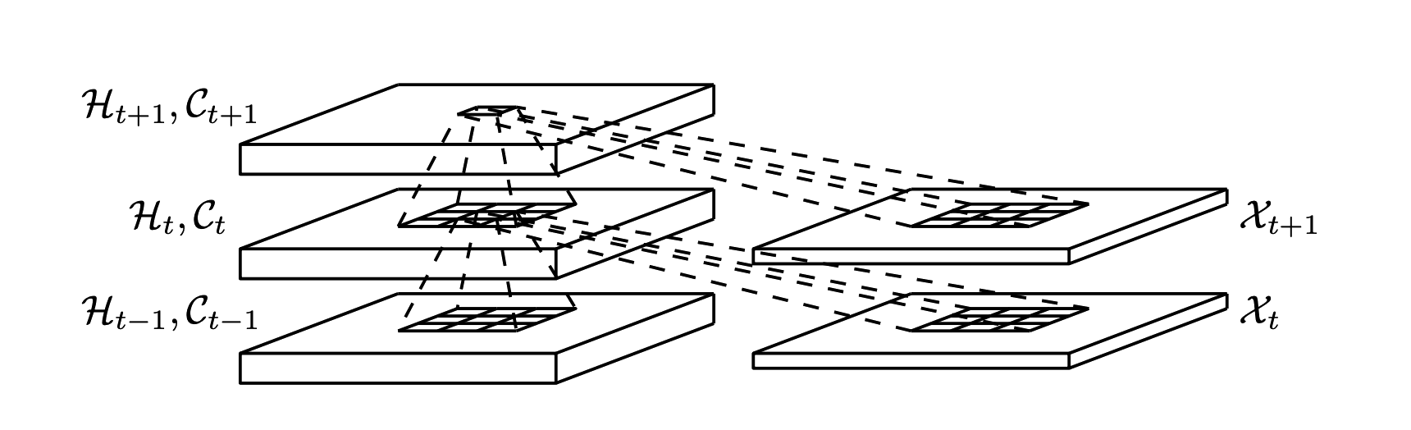
Spatiotemporal Modeling for Crowd Counting in Videos(ICCV 2017)

Slide 8
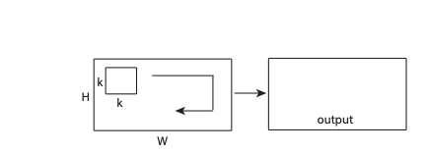
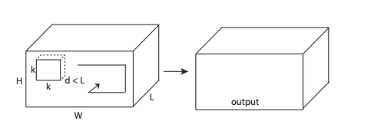
C3DNet
Learning Spatiotemporal Features with 3D Convolutional Networks(CVPR 2015)

Slide 9
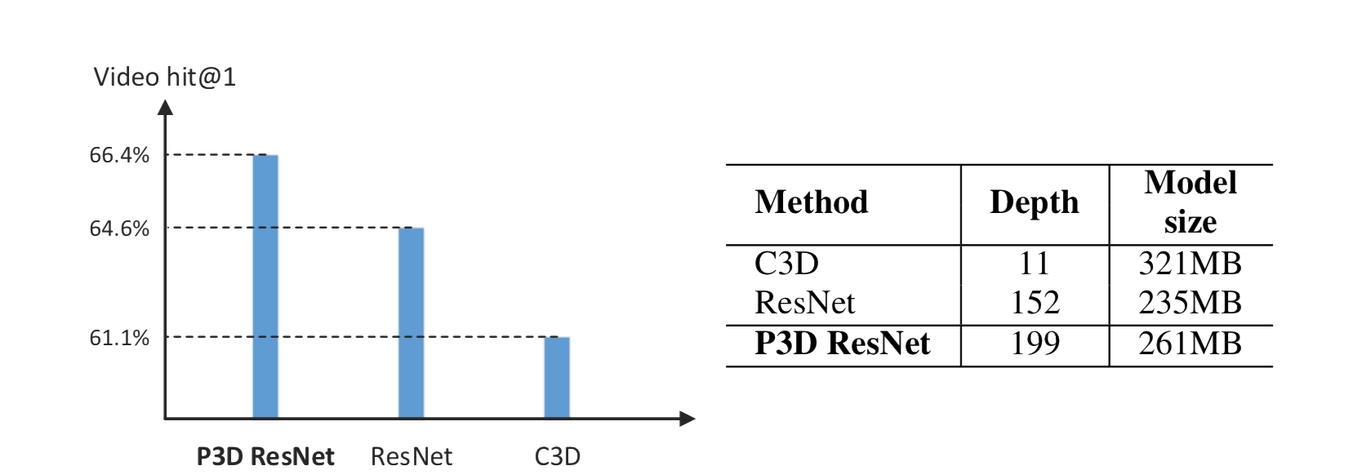
Comparisons of different models on Sports-1M dataset

Slide 10
Three designs of Pseudo-3D blocks.
1x3x3
3x3x3
3x1x1
Notes:
那么如何排列两个卷积

Slide 11
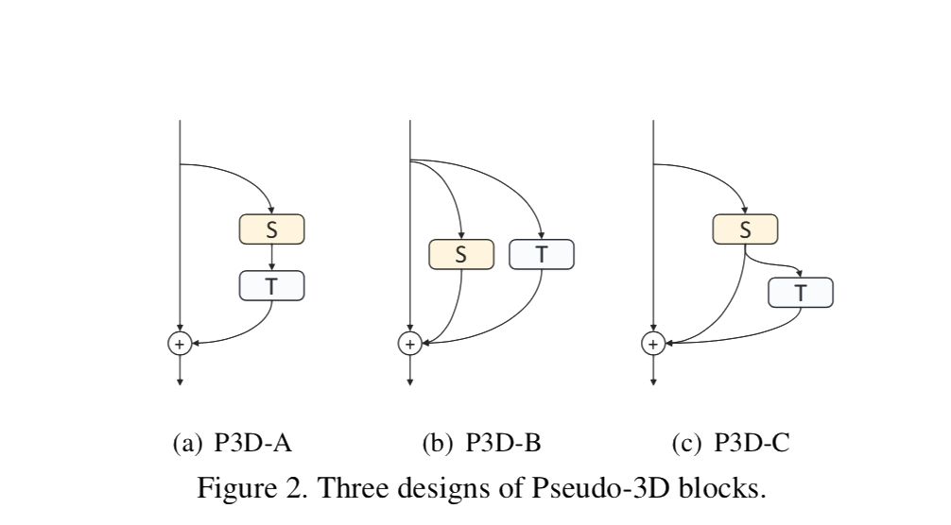
Three designs of Pseudo-3D blocks.

Slide 12
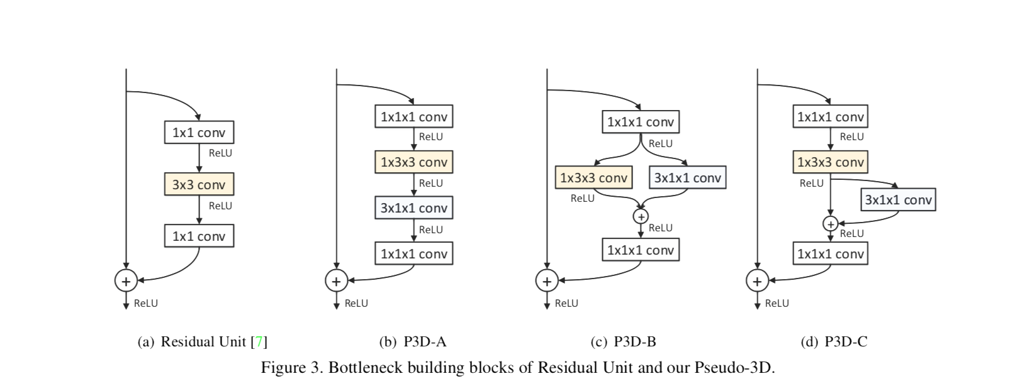
Bottleneck building blocks of Residual Unit and our Pseudo-3D
Notes:
迁移学习

Slide 13
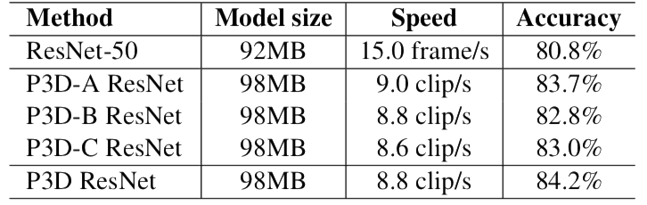
Performance and Time Efficiency on UCF101

Slide 14
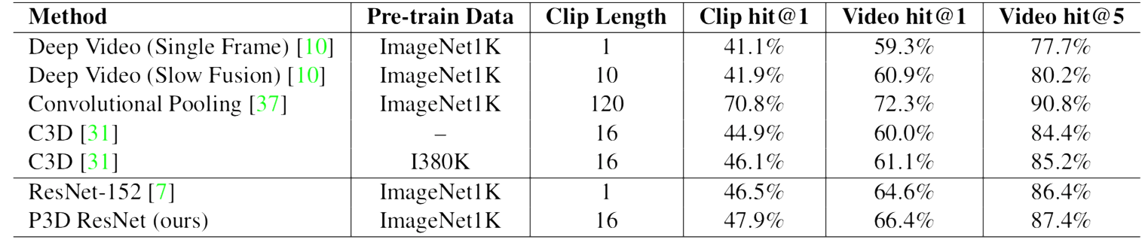
Comparisons on Sports-1M

Slide 15
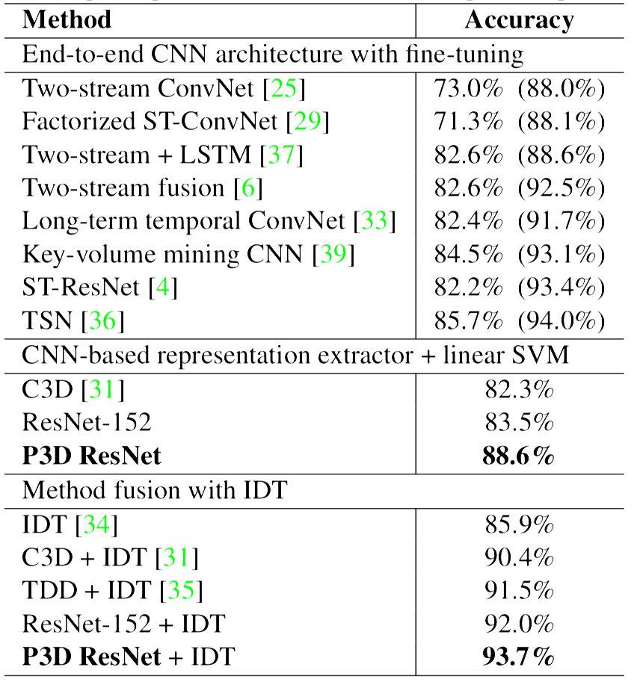
Comparisons on UCF101

Slide 16
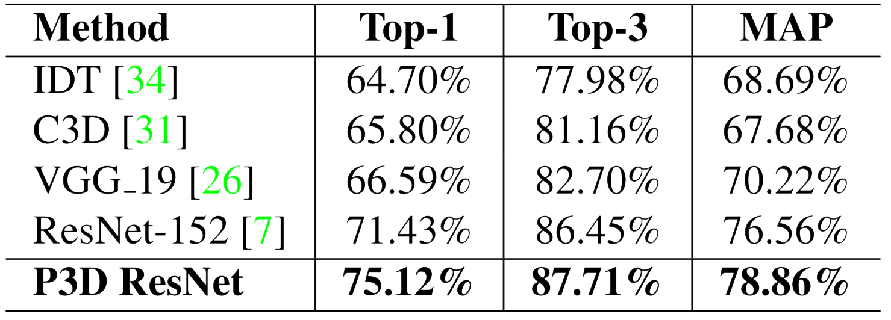
Comparisons on ActivityNet

Slide 17
P3DNet Architectures
 | Output size | 63-layer | 131-layer | 199-layer
conv1 | 160x640x16 | 1x7x7, 64, stride1x2x2
max pool(Deprecated) | 80x80x16 | 2x3x3, stride2
conv2_x | 40x40x16 | 3 | 3 | 3
max pool(Deprecated) | 40x40x16 | 2x1x1, stride2x1x1
conv3_x | 20x20x16 | 4 | 4 | 8
max pool(Deprecated) | 20x20x16 | 2x1x1, stride2x1x1
conv4_x | 10x10x16 | 6 | 23 | 36
max pool(Deprecated) | 10x10x16 | 2x1x1, stride2x1x1
conv5_x | 5x5x16 | 3 | 3 | 3
 | output

Slide 18
Future works
Model compression
Try optical flow and others
How to train the model
Why this model work?
Which loss func is better?

Slide 19
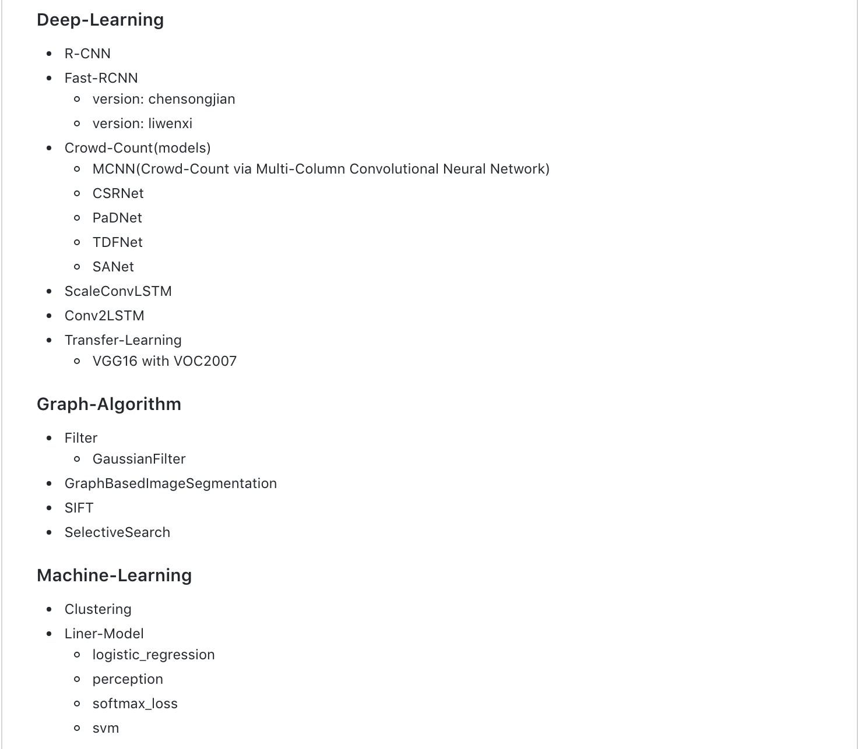
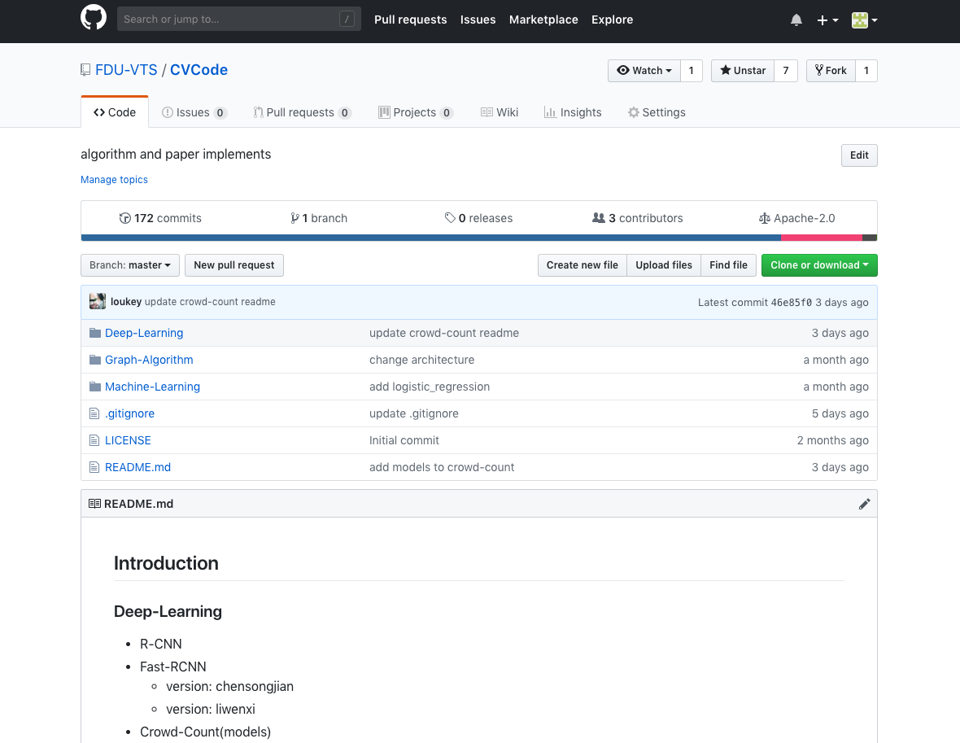
Codes
https://github.com/FDU-VTS/CVCode

Slide 20
THANKS

